Slide 1
Wearable Devices
COMPUTER LITERACY

Slide 2
Factors in Wearable Tech Today
Faster and cheaper hardware
Cloud storage
Location data
Quantified self activity
Visual & voice technology
Personalization
Gaming industry

Slide 3
Devices
Audio-video capturing devices
Body data gathering devices
Gesture recognizing devices
Other devices proposed in research

Slide 4
Audio-Video Capturing Devices
Logging Life Events

Slide 5
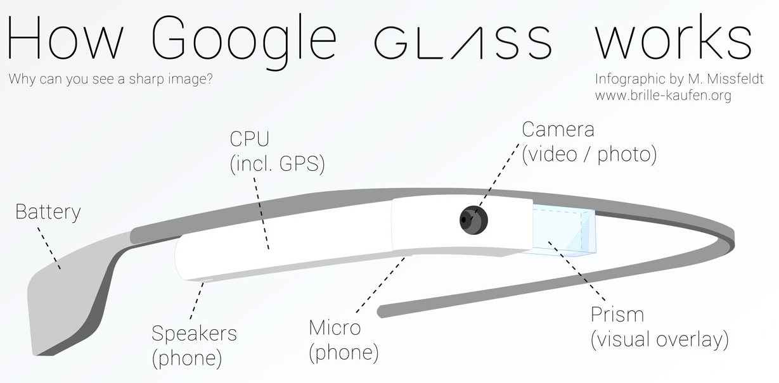
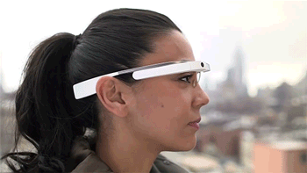
Google Glass (Smart Glasses)

Slide 6
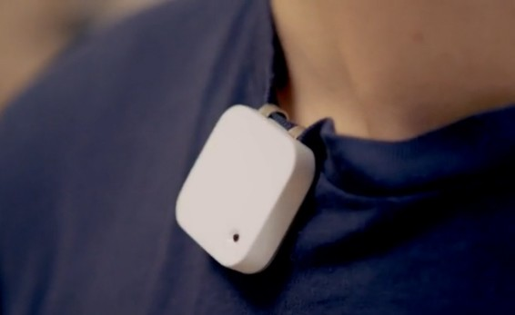
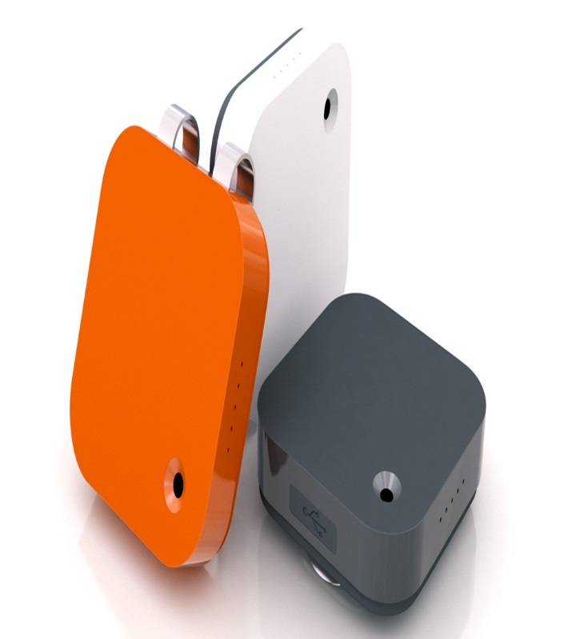
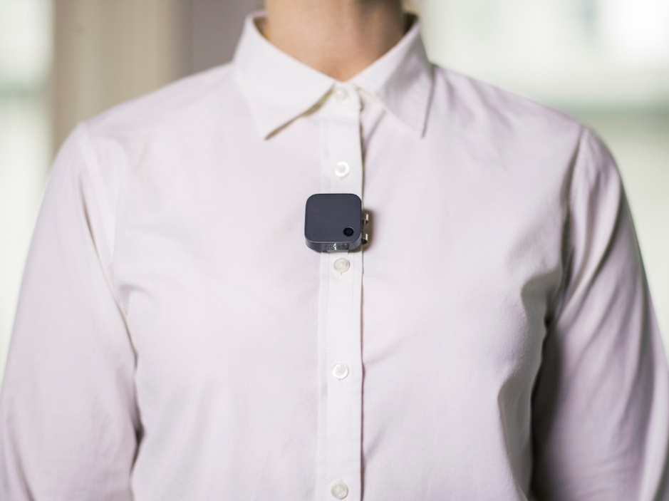
Narrative Clip (First Person Camera)
http://getnarrative.com/

Slide 7
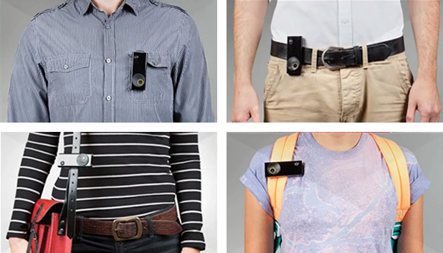
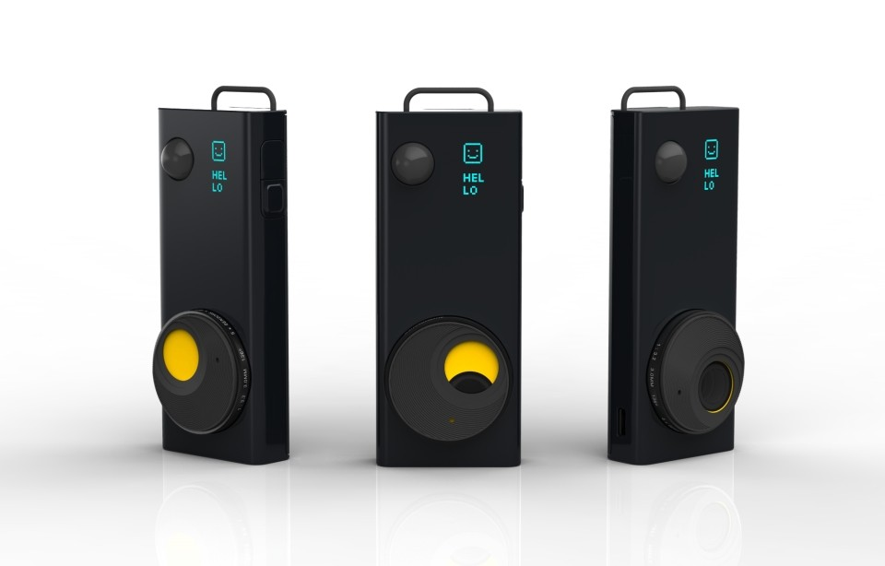
Autographer (First Person Camera with Sensors and GPS)

Slide 8
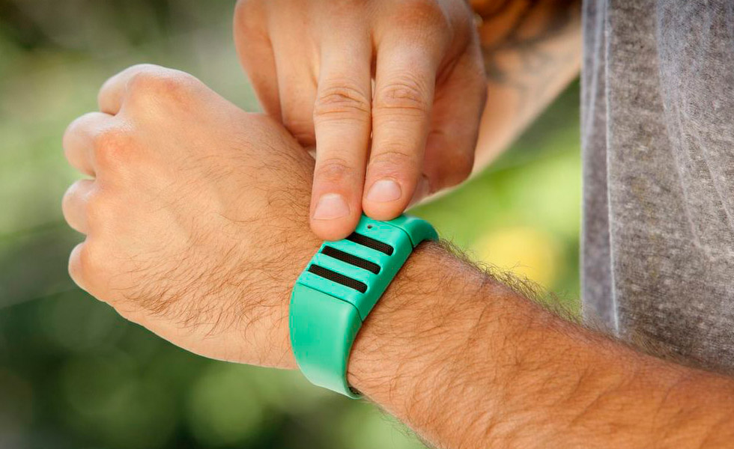
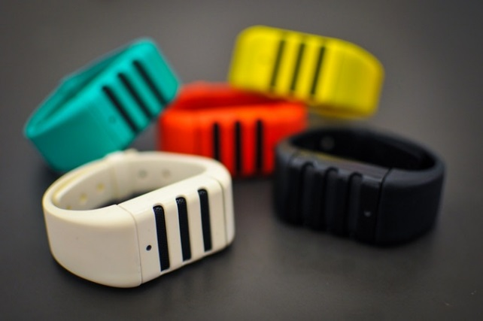
Kapture (Autonomic Audio Capture)
https://kaptureaudio.com/

Slide 9
Body Data Gathering Devices
Monitoring Health Status

Slide 10
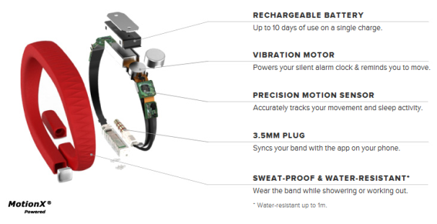
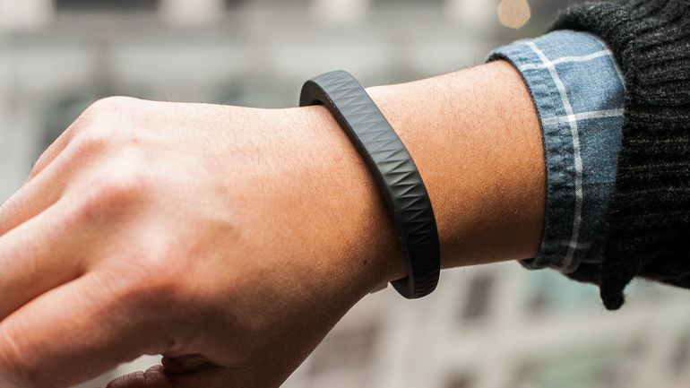
Jawbone (Activity Monitor)

Slide 11
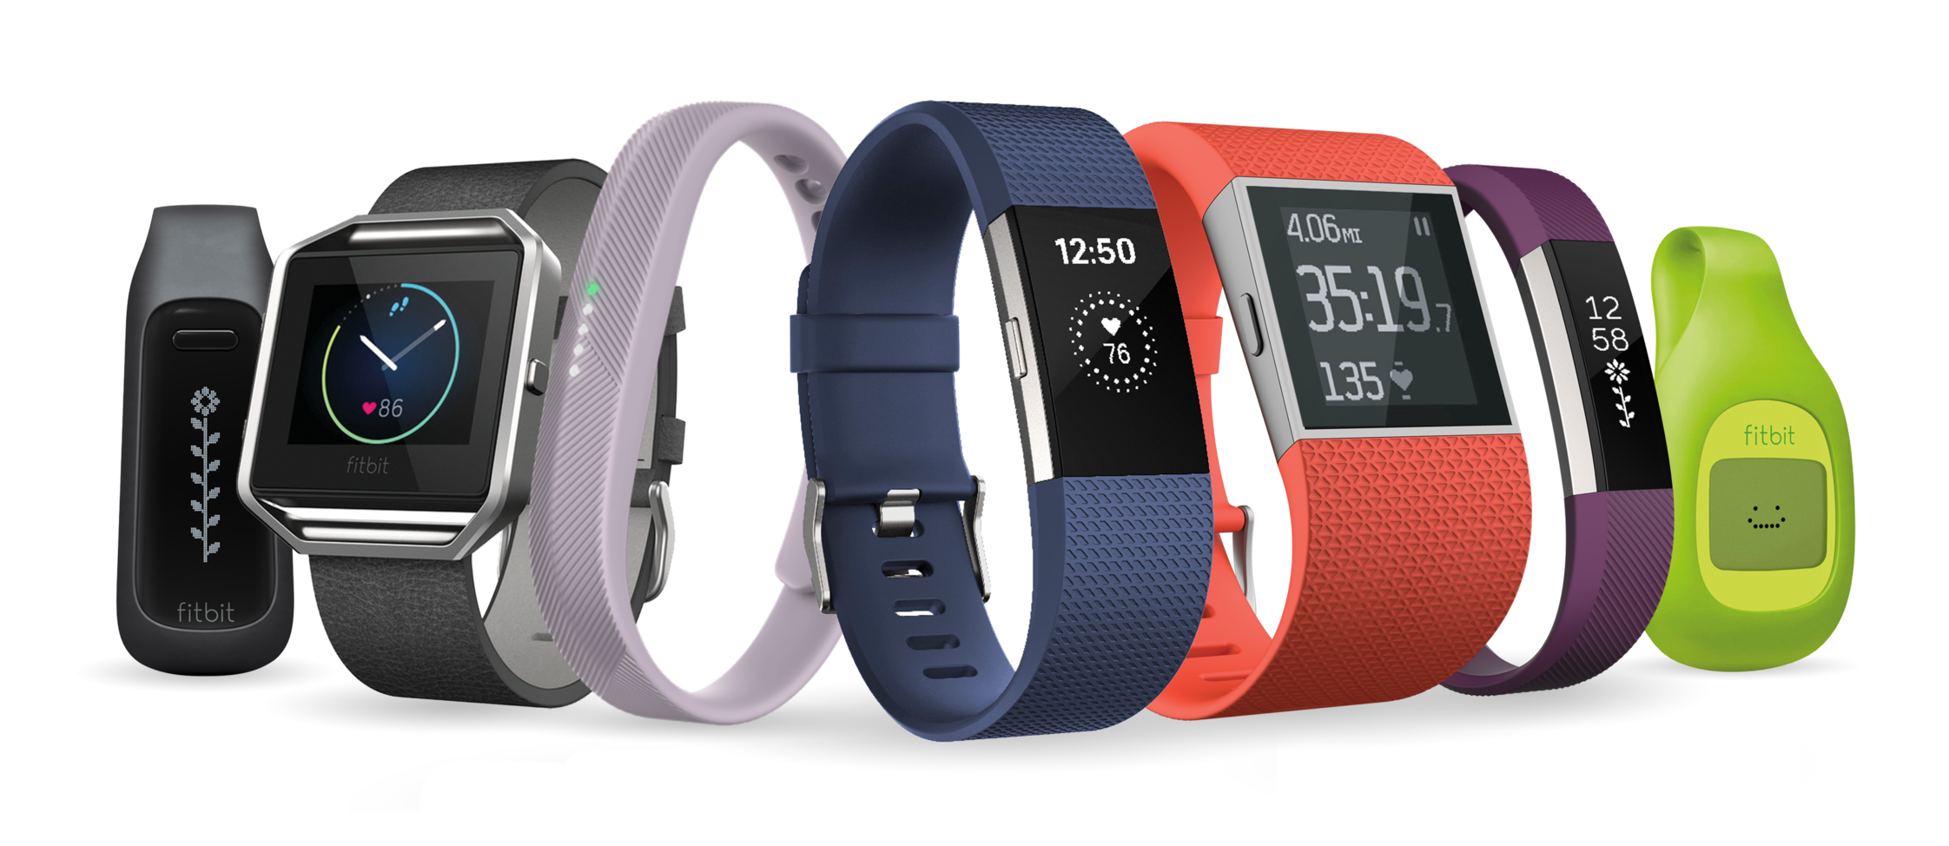
Fitbit (Fitness Tracker)

Slide 12
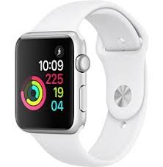
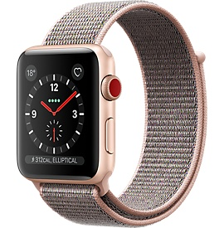
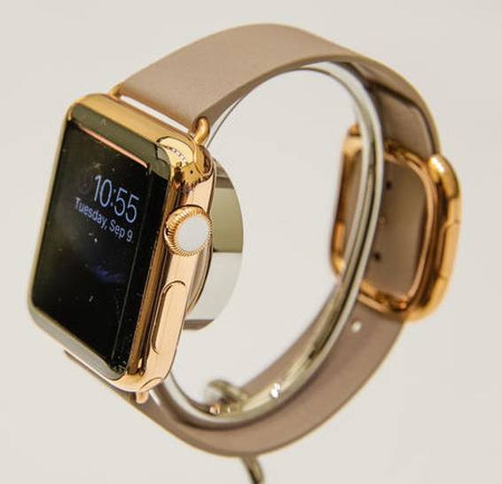
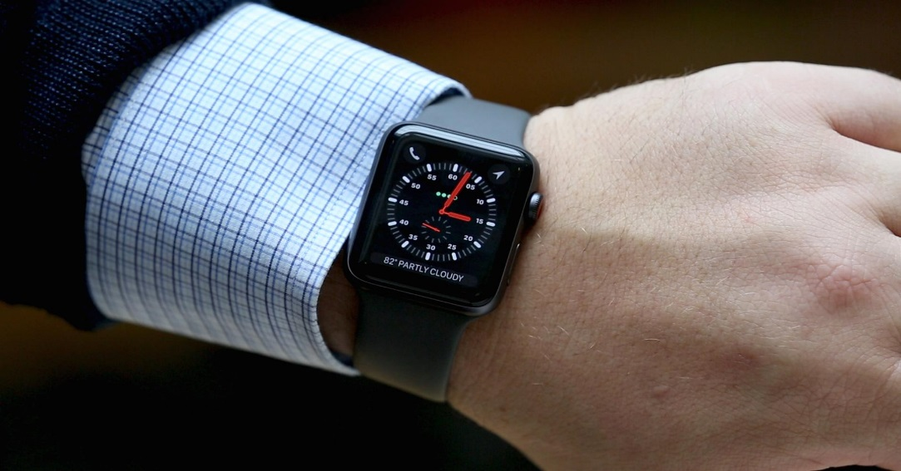
Apple Watch

Slide 13
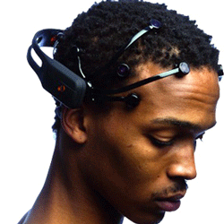
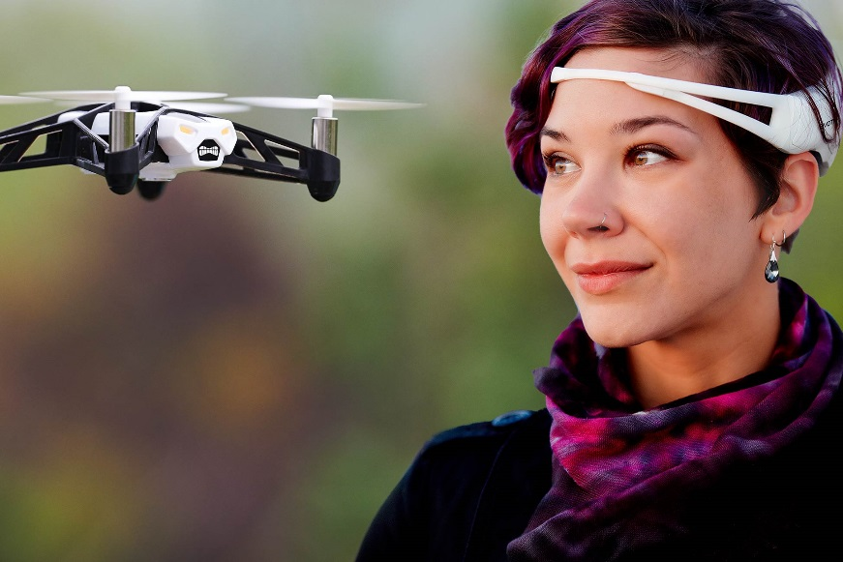
Emotiv (Brain Activity Tracker –EEG)
https://www.emotiv.com/

Slide 14

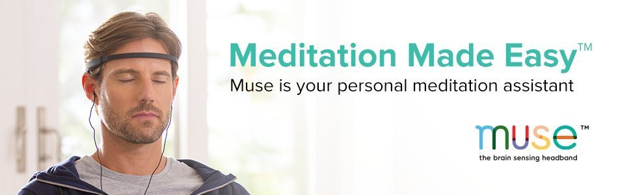
Muse (Brain Monitor)
http://www.choosemuse.com/

Slide 15
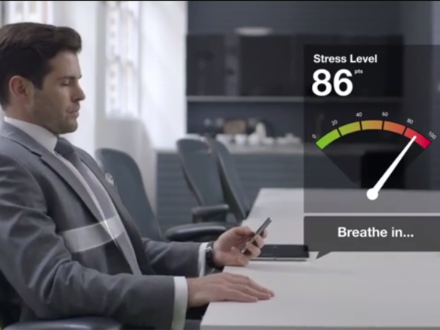
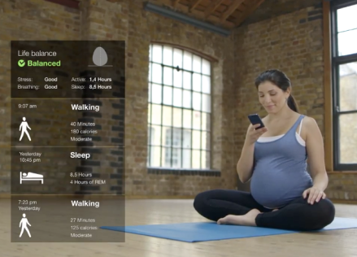
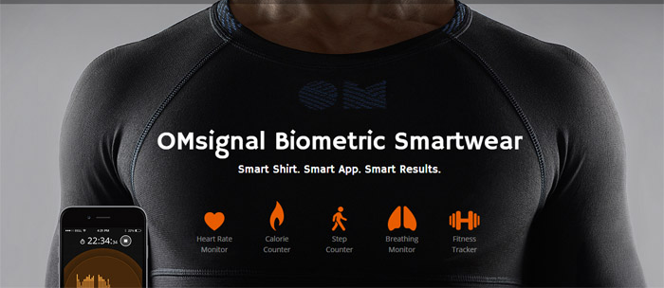
OmSignal (Smart Shirt)

Slide 16
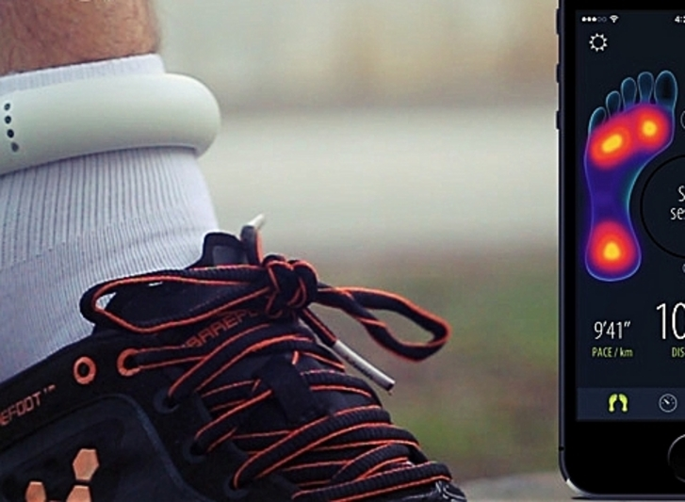
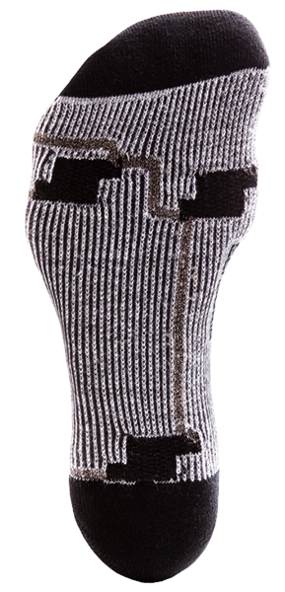
Sensoria (Smart Socks)

Slide 17
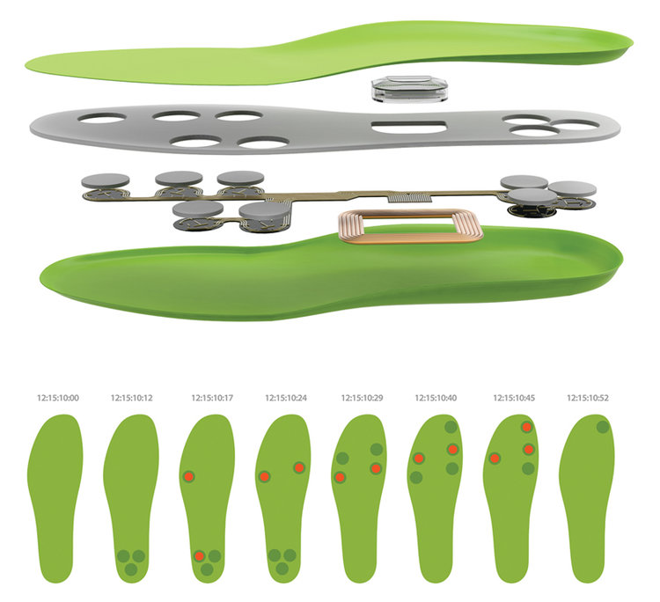
FootLogger (Shoe Sole for Fitness Tracking)

Slide 18
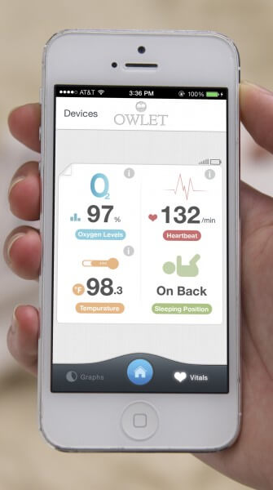
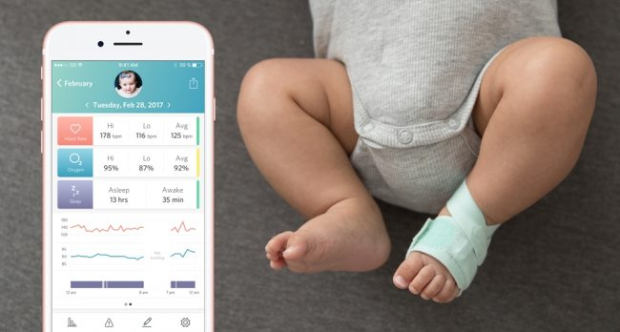
Owlet (Baby Status Monitoring)

Slide 19
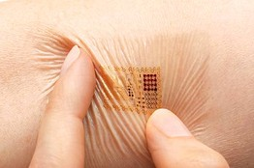
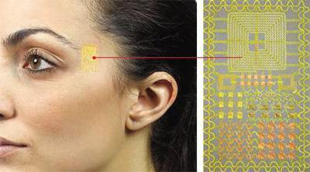
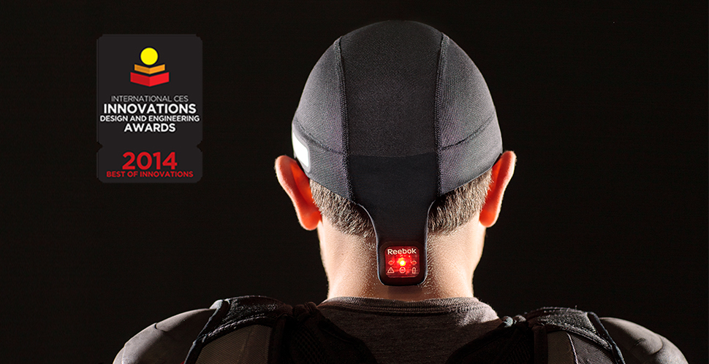
MC10 (Flexible wearable sensors for health monitoring)

Slide 20
Gesture Recognizing Devices

Slide 21
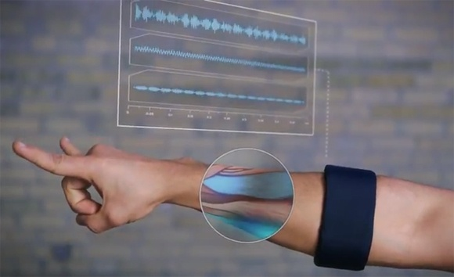
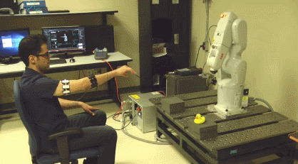
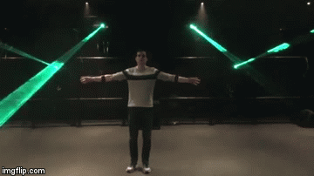
Myo (Muscle Activity Tracker)

Slide 22
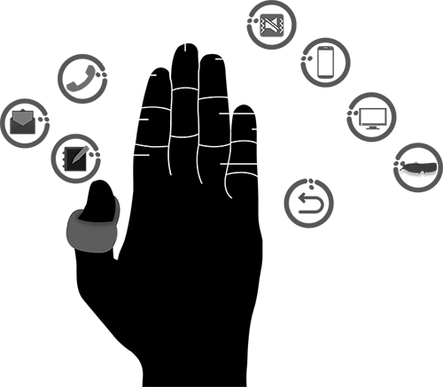
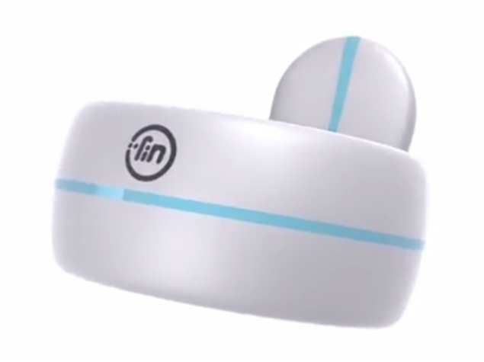
Fin (Another Smart Ring)
Ring GINA (MobiCase 2013) for 3D gestures

Slide 23
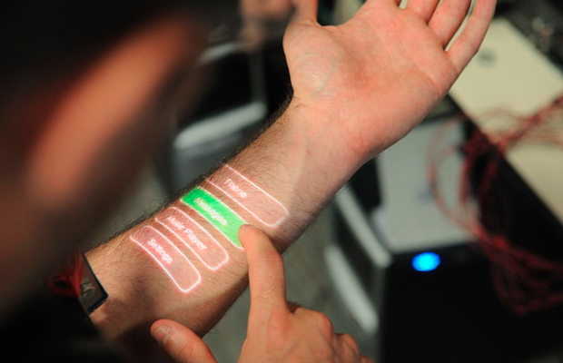
SkinPut (MSR)

Slide 24
Wearables discussed in Research Papers

Slide 25
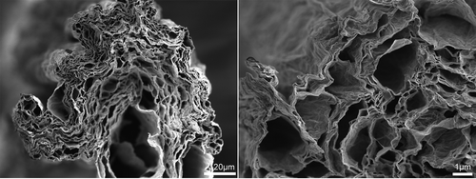
New Wearables – Energy Storage Textiles
High-Performance Multifunctional Graphene Yarns: Toward Wearable All-Carbon Energy Storage Textiles (ACS Nano, 2014).

Slide 26
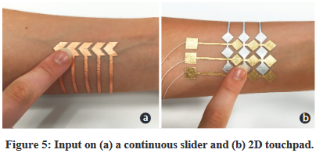
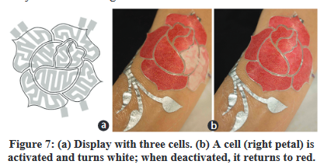
New Wearables – Smart Temporary Tattoos
DuoSkin: Rapidly Prototyping On-Skin User Interfaces Using Skin-Friendly Materials (International Symposium of Wearable Computers, 2016)

Slide 27
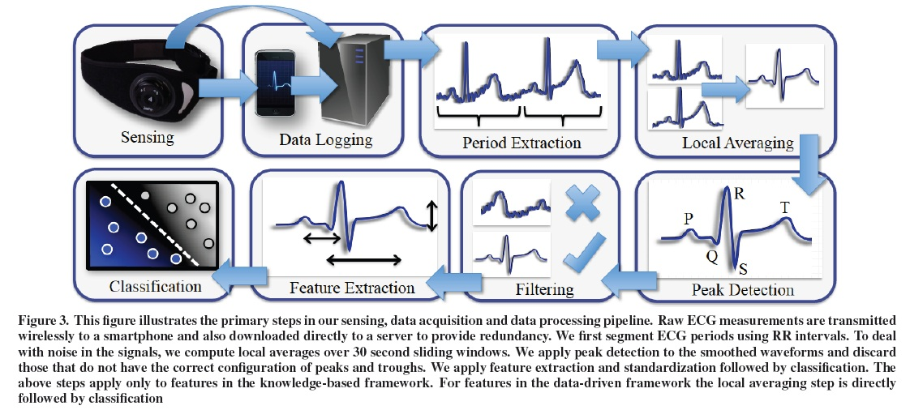
New Wearables – New Applications
Detecting Cocaine Usage through Wearable ECG Sensor (UbiComp 2013)

Slide 28
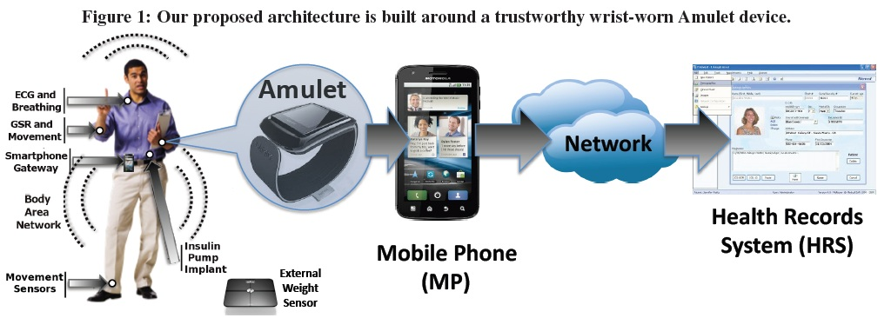
New Wearables – New Applications
An Amulet for Trustworthy Wearable mHealth (HotMobile 2012)

Slide 29
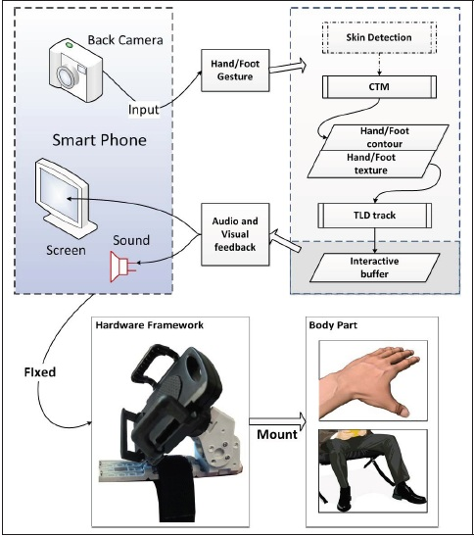
New Wearables – New Applications
Wearable Smartphone: Wearable Hybrid Framework for Hand and Foot Gesture Interaction on Smartphone (CVF, ICCV 2013)

Slide 30
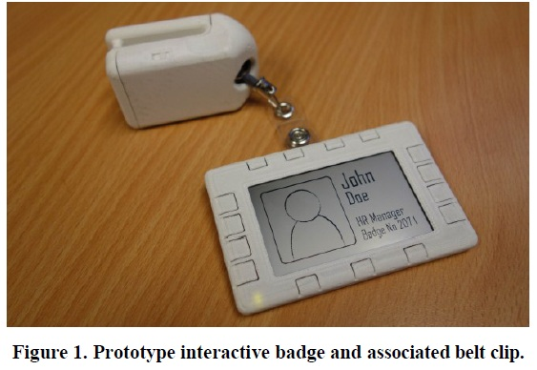
New Wearables – New Applications
An Interactive Belt Worn Badge (CHI 2012)

Slide 31
Classification of Wearables
By Function
Life Logger
Gesture Recognizers
Entertainer
Video
Gaming
Assistant
For Chore Jobs
For Creative Jobs
For Emergency Jobs
By Creation
Replace daily wearables with smarter alternatives
Watches, Shirts, Shoes, Socks etc.
Create new wearables
Armband, Headband, Shirt Clippers etc.

Slide 32
Applications
Life logging
Activity tracking / monitoring
Healthcare
Gesture recognition
Remote control
Research
Augmented Reality

Slide 33
Concerns
Privacy
Security
Energy
Misinterpretation

